Slide 1
Superstore

Slide 2
Problem Statement
Regional sales director wants to know:
What the best product category is and why?
What the best customer segment is and why?

Slide 3
Overall Product Category Order Requests, Sales & Profit
Notes:
I looked at a range of data to answer this.
In terms of Product Category:
I looked at Order Requests - Office Supplies is the Product category with most order requests – by a significant amount too
The Binders, Storage and Art subcategories have the most order requests
Yet total Sales and Profit figures show Technology is more of a fruitful Product Category

Slide 4
What are the Quarterly Product Category Trends for Sales & Profit?
Technology in 2019 Q4 performed well for both profit and sales
Were there Black Friday sales offers on in this period? Demand for phones in this period?
Office Supplies was Top in 2019 Q3 and 2018 Q3 in terms of Profit – Back to School/Office Supplies trend?
Q4 outperforms the rest of the year
Discount Ranges on average higher for Furniture – hence low profit overall
Notes:
I looked at Quarterly Product Category charts for trends
Technology is often a high performer
2019 Q4 did well for both profit and sales – especially in November
Were there Black Friday sales offers on and demand for phones in this period?
Office Supplies was top for profit in 2019 Q3 and 2018 Q3 – was there a Back to School or Office trend then?
Furniture sales tend to be higher than Office Supplies sales per quarter but has rarely made more profit than Technology or Office Supplies
Generally, sales and profits increasing over the years
Q4 outperforms the rest of the year
Discount Ranges - is on Average higher for Furniture – hence the low profit overall

Slide 5
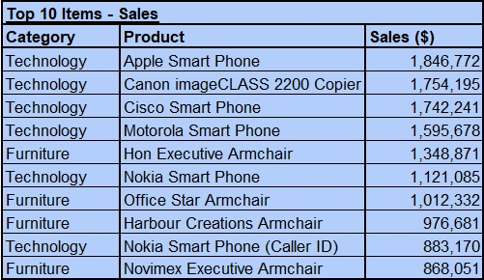
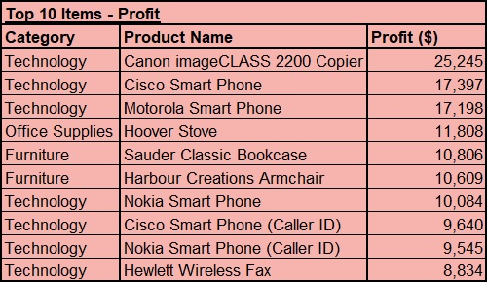
Subcategories & Items - Sales & Profit Trends
Notes:
I looked closer at subcategories
Copiers and phones still the most profitable overall – worth investing in as key products
Top 10 items are mainly in Technology
Phones give high sales - Apple Phone brings in the most.
But Canon Copier is the most profitable overall.
Apple Phone is not even in the top 10 most profitable. Why? Are we selling Apple Smart phones at a significant loss? We need to investigate further
No point selling Tables as they’re bringing negative profit, its an outlier
I probed into November Technology Profit figures - shows high Copier sales was the main reason for November spike

Slide 6
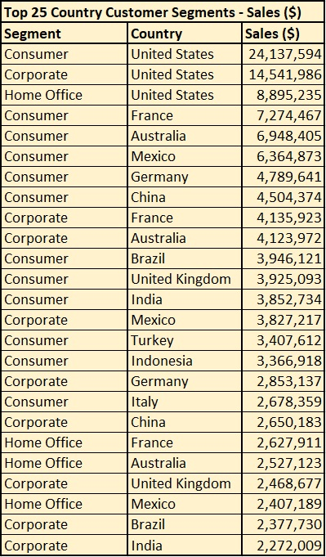
Customer Segment Comparison Sales Figures & What Countries Are These Sales Coming From
Consumer and Corporate Furniture sales slightly higher than Consumer and Corporate Office Supplies
Consumer technology figures still the strongest
Total of all business sales = 245m.
Top 25 makes up 131m (approx.) in sales – more than half of sales revenue.
United States represents 46m approx.
Notes:
Decided to compare Sales figures by Customer Segment.
Technology is the Consumer Segment that’s a major sales driver.
I found that the Consumer + Corporate Furniture sales are slightly higher than the Consumer + Corporate Office Supplies
Also Looked at Top 25 performing Countries for sales and segments
United States makes 24m in Consumer sales and 46m in sales in total
Should keep United States as main customer segment target focus
Total sales is 245m out of 146 countries

Slide 7
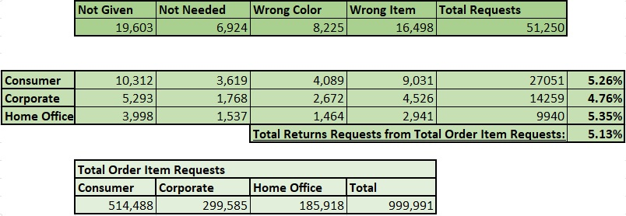
Number of Order Item Returns Requests by Customer Segment
Consumer segment has the highest return requests
Total Return Request only makes up approx. 5% of all Item Order Requests and in all Customer Segment too
Still relatively low in comparison to approx. 999k total item order requests
Total % of Respective Customer Segment
Notes:
I looked at Order Item Return Requests by Segment
The consumer segment has the highest return requests
Total Return Request only makes up approx. 5% of all Order Item Requests and in all Customer Segments too
Still relatively low in comparison to approx. 999k total item order requests
Return Requests have a low impact on Order Item Requests overall

Slide 8
What I Would Look Further Into
Look into the quarterly performance of each item
Does the salesperson involved make difference to sales/profit per order?
Why are some products selling at a loss in certain categories and orders?
Notes:
What I’d Look Further Into:
Look into the quarterly performance for each item
Look into if the salesperson involved makes a difference to sales?
And find out why are some products selling at a loss

